Slide 1
HMDCB Certification
HMDCB Volunteer Name
INSERT DATE
Notes:
By being here you have demonstrated a commitment to improve the quality of care for hospice patients.
The HMDCB Board of Directors feels certification is one initiative helping meet that commitment.

Slide 2
HMDCB Certification
Unique subset of HPM
Administrative, Leadership, Regulatory, Legal and Clinical skill sets are assessed
Purpose
Certification of HMDs has the potential to improve the quality and consistency of the practice within HPM and the care provided by local hospices
Credential
Hospice Medical Director Certified® (HMDC®)
Notes:
Several colleagues have asked how this is different than the ABMS or AOA examination. It’s complimentary, but specific to the practice of hospice medicine. It assesses additional competencies to perform the role of the HMD, such as: administrative, regulatory, legal competence, and clinical skills appropriate for the imminently dying.

Slide 3
HMDCB Eligibility
Target Audience
Physicians who provide hospice care either full or part-time
Geared toward the physician who has at least 2 years of experience in a hospice setting
Notes:
Not limited to HMDs, but any physician within a hospice who might share responsibilities of the HMD role or desire to become the senior HMD.

Slide 4
HMDCB Initial Certification
Requirements for all candidates
Licensed in US or Canada
Agree to Code of Professional Conduct
400 hours of hospice related activities
Must meet one of three pathways
Fellowship in HPM
HPM Certification through ABMS/AOA
Two years of Practice experience in hospice
Pass the examination (fee $1100)
Notes:
Hospice related activities are defined on the HMDCB website. These are activities within the hospice setting as outlined in the content blueprint
If fellows completed 200 hours during their training, additional time would need to be spent in the hospice setting to meet the “fellowship pathway”. Similarly, if a physician is HPM certified, he/she will still need to record 400 hours of hospice related activities.

Slide 5
CONTENT Blueprint
Five Competency Areas
Patient and Family Care
Medical Knowledge
Medical Leadership and Communication
Professionalism
Systems-Based Practice
Notes:
Based on the practice analysis (explain)
Note System-based Practice includes ethics, regulatory, quality, etc.

Slide 6
WHY GET Certified?
“Having a mechanism whereby I could attain certification as a hospice medical director is a great opportunity for someone like me for whom the path to board certification is not an option. It would serve to validate my competency.“
Bernice Burkarth, MD HMDC
Hospice Medical Director, Stuart, FL
Notes:
Here is a perspective from a physician who’s served as an HMD for 10 years and seeks to earn recognition by her employer and peers.

Slide 7
WHY EARN the Hospice Medical Director Certified (HMDC®)?
Career advancement, increases marketability
Professional recognition and credibility
Connection with a network of more than 800 certified peers
Improves relevancy staying current with MOC requirements
Notes:
HMDCB has achieved more than 800 certificants in only four certification cycles.

Slide 8
TIMELINE
Annual
Examination window Mid-May
Application cycle opens late November
Computer based testing at 300 PSI testing centers across US
2018
Maintenance of Certification Program
Notes:
PSI is the testing company HMDCB has contracted with to guide development and administer the computer based exam. PSI has a unique model locating most of their testing centers adjacent to H&R Block offices in a secure, proctored environment.
The test is offered annually in mid-May. Applications will be open in late November.
The Recertification, or Maintenance of Certification, program is currently being developed and will be announced in 2018. Initial certification is valid for 6 years.

Slide 9
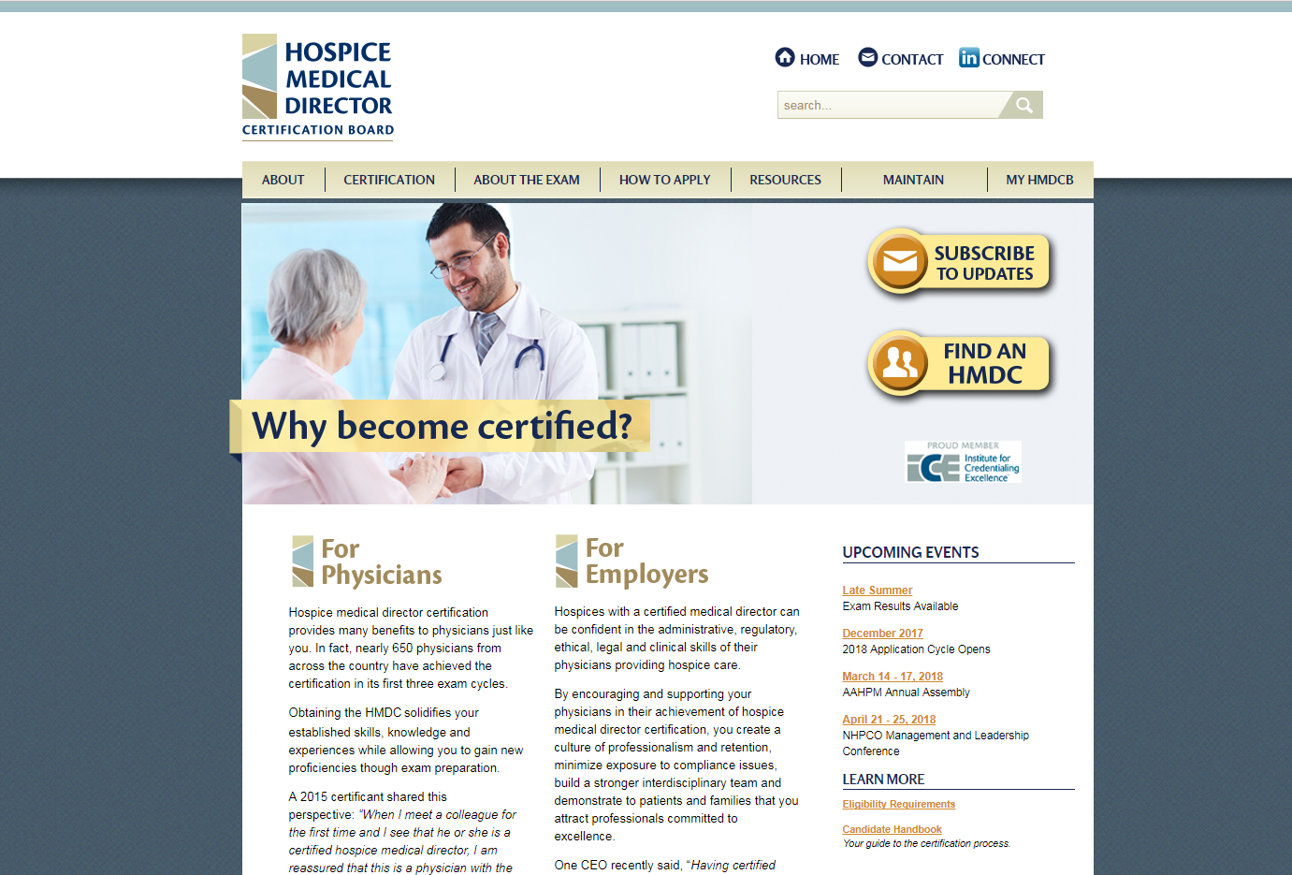
www.HMDCB.org
Notes:
Through the website you can also subscribe to updates on the program and receive emails such as registration announcements.

